Slide 1
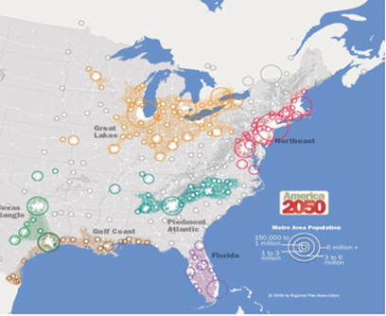
What drives Prospect Location Decisions?
Access to Markets
Workforce
Fiber Access / Technology Infrastructure
Logistics Infrastructure
Transportation Costs
Rail
Drayage for Trucking
Shipping Costs
Total Costs of Ownership (TCO)
Energy Costs
Utility Costs
Tax Rates
Capital Investment
Virginia is at the crossroads of access to three major markets…

Slide 2
Regional Energy Infrastructure & Power Plants

Slide 3
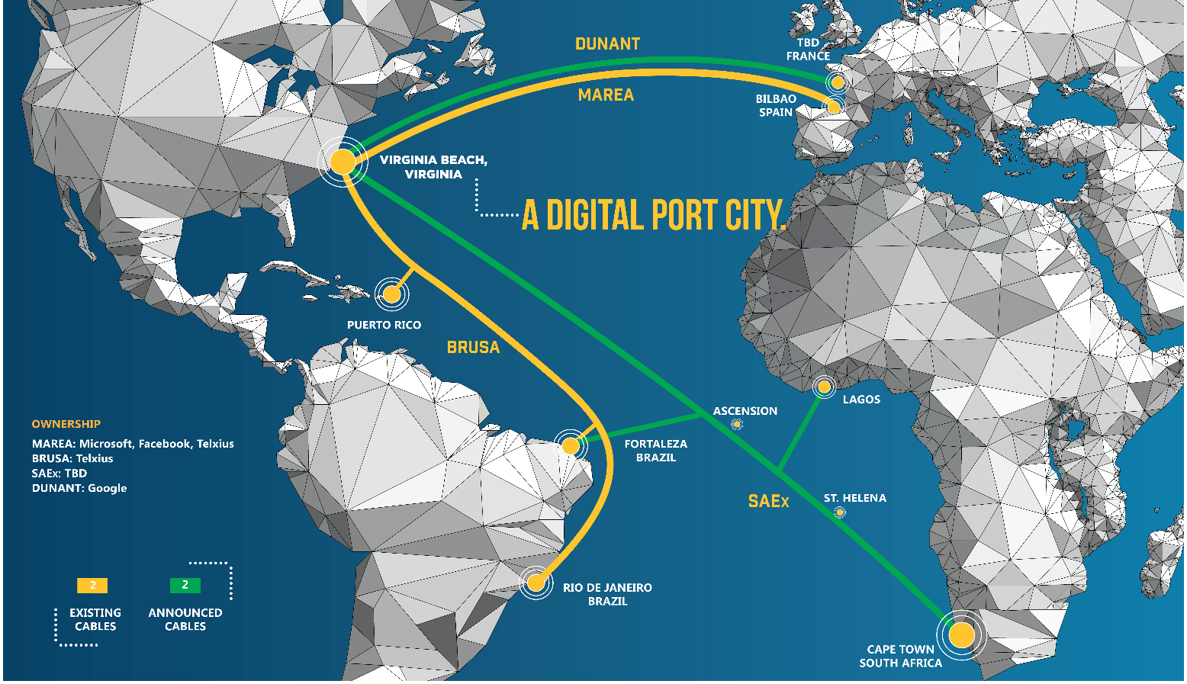
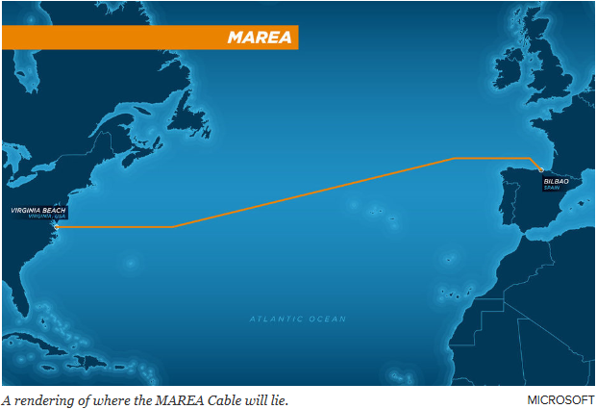
Digital Infrastructure - Va Beach Cable Landings

Slide 4
Submarine Cable Maps

Slide 6
Elec Providers Coverage
Electric Provider in Virginia | Service Area (Sq Mi) | % of Virginia
Dominion | 10,413 | 26.2%
APCo | 9,884 | 24.9%
Rappahannock | 3,957 | 9.9%
Southside | 3,016 | 7.6%
Shenandoah Valley | 2,426 | 6.1%
Mecklenburg | 1,809 | 4.5%
CVEC | 1,609 | 4.0%
BARC | 1,290 | 3.2%
Craig Botetourt | 773 | 1.9%
Community | 679 | 1.7%
Northern Virginia | 678 | 1.7%
Prince George | 587 | 1.5%
ANEC | 552 | 1.4%
Northern Neck | 478 | 1.2%
Kentucky Utilities | 438 | 1.1%
City of Danville | 431 | 1.1%
Powell Valley | 382 | 1.0%
City of Bedford | 122 | 0.3%
Bristol Power Board | 120 | 0.3%
Franklin | 37 | 0.1%
Harrisonburg Electric Cooperative | 18 | 0.0%
City of Salem | 14 | 0.0%
City of Martinsville | 11 | 0.0%
Town of Front Royal | 10 | 0.0%
City of Manassas | 8 | 0.0%
City of Radford | 7 | 0.0%
TownofCulpeper | 7 | 0.0%
VPI&SU | 6 | 0.0%
Town of Blackstone | 5 | 0.0%
Richlands | 3 | 0.0%
none | 1 | 0.0%
Town of Elkton | 1 | 0.0%
Town of Wakefield | 1 | 0.0%
Grand Total | 39,773 | 100.0%
Dominion: 26.2%
AEP: 24.9%
Rappahannock: 9.9%
Southside: 7.6%
Shenandoah Valley: 6.1%
Notable:
NOVEC: 1.7%
(Data Center Alley)

