Slide 1
Department of Virginia Housing and Community Development
Office of Broadband
Broadband Together Conference
May 18, 2022

Slide 2
Outline
Looking Back + Celebrating Successes
Current Initiatives
What’s Coming Next?

Slide 3
Looking Back + Celebrating Our Success
Growth of VATI
Support of the Commonwealth Connect Coalition
Success: Roanoke County

Slide 4
VATI Funding
Availability & Sources
FY2022 VATI
57 Applications from 84 localities
$943.3 million requested
---
$722 million awarded
$1 billion leveraged
Universal Coverage for 70 Localities
278,550 connections

Slide 5
VATI Active Grants Portfolio
47 VATI Contracts, not incl. FY22 Awards
22 Open Contracts
14 Construction Completed
11 Close Out Process Complete
10 open contracts granted timeline extension
Ranging from 6 months to 1 year
COVID related delays (i.e. materials, staffing issues, etc.)
---
35 Contracts Pending for FY22 Awards

Slide 6
Commonwealth Connect Coalition Support
130 members of the Commonwealth Connect Coalition, all supporting:
Universal Broadband Access in Virginia
Full Funding for the Virginia Telecommunication Initiative

Slide 7
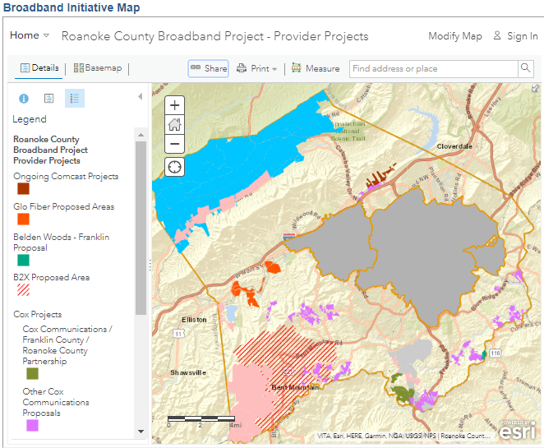
Success Story:
Roanoke County
Previously Unsuccessful VATI Applicant
Submitted 4 Applications in FY22 VATI Round, with:
Cox
Shentel
Craig-Botetourt Electric Coop
B2X
All Collectively Awarded:
$7.7 Million
Passing 1,394 Locations
Combination of Wireline and Wireless Technology
Produces Universal Access in the County

Slide 8
Current Initaitives
Commonwealth Connection Released
Line Extension Customer Assistance Program
BEAD in Virginia
FY23 VA Telecommunication Initiative

Slide 9
“Commonwealth Connection”
Virginia’s New Broadband Availability Map
Percent of Broadband Availability by Census Block
Incorporated Analysis Tools for Local Leaders
The Virginia Department of Housing and Community Development (DHCD), in partnership with the Virginia Tech Center for Geospatial Information Technology, is developing a statewide broadband availability map indicating broadband coverage, including maximum broadband speeds available in service territories in the Commonwealth. Broadband service providers are required to submit updated service territory data to the Department annually.
Greater focus on Virginia’s unserved

Slide 10
Line Extension Customer Assistance Program - LECAP
Guidelines and Criteria
Public Input: April 2022
Request for Interest
Launching:
Late April 2022
For a subset of Virginians, broadband connections are not attainable because their home exceeds an internet service provider’s standard connection drop length from a roadway or easement containing telecommunications infrastructure. The cost incurred by home owners to extend broadband infrastructure to these locations, referred to as special construction costs, range from a few hundred to a few thousand dollars, depending on the distance and cost to connect the location.
Hiring LECAP Administrator
April 2022

Slide 11
Broadband Equity, Access, and Deployment (BEAD) Program
BEAD Eligible Expenses
BEAD Program Next Steps
Governor Youngkin established DHCD as the point of contact for IIJA Broadband Programs, including BEAD
DHCD will be developing the Commonwealth’s 5-Year Plan required by BEAD over the coming months
Planning / pre-deployment funds (no more than 5% of min. allocation)
Research & data collection
Budget development
Publications, outreach & communication support
Provision of technical assistance
Employee training for eligible entity or political subdivision staff
Establishing capacity in the eligible entity’s office responsible for program
Grant / deployment funds
Unserved & underserved area service projects
Connecting eligible community anchor institutions
Data collection, broadband mapping & planning
Broadband adoption (incl. affordable device provision)
Installing internet/Wi-Fi infrastructure (or providing reduced cost broadband) in multi-family residential building
Eligible entities can use no more than 2% for administrative purposes

Slide 12
FY2023
Virginia Telecommunication Initiative Grant Making Process
Timeline
May 20 – DHCD releases Final Guidelines for the FY2023 VATI Round
June 2, 12pm - 2pm – VATI How-to-Apply Webinar, Applications Open
June 2 – August 25 – VATI Technical Assistance and Project Development Sessions
July 7 – Notice of Applications Due
August 25 – Applications Due
October 6 – Challenges Due
October 13 – DHCD Notifies Challenged Applicants
November 3 – Deadline for Challenge Rebuttals
December 8 – DHCD Notifies All Parties of Challenge Determination
Late December – Anticipated Announcement of Award

Slide 13
What’s Coming Next?
Bipartisan Infrastructure Law Programs
Digital Affordability and Cost Effectiveness Plan
Broadband Service to New Development Study
VATI Project Dashboard

Slide 14
Infrastructure ACT* creates ~$65B in BROADBAND funding
NTIA will administer ~$48B of this new funding
FCC to administer ~$14B
$14.2B
BEAD
DIGITAL EQUITY
TRIBAL
MIDDLE MILE
For Affordable Connectivity Program, which will replace the EBB program
$42.45B
$2.75B
$2.00B
$1.00B
USDA to administer $2B
Title I - Broadband Equity, Access & Deployment Program
Formula-based grant program for U.S. states and territories. BEAD aims to close the access gap for unserved & underserved areas of the country.
Title III – Digital Equity Act
Three programs, established for planning & implementation of programs that promote digital equity, support digital inclusion activities, and build capacity related to the adoption of broadband.
Title II - Tribal Connectivity Technical Amendments
Furthers current Tribal Broadband Connectivity Program by investing an additional $2B to fund broadband adoption and infrastructure projects.
Title IV - Enabling Middle Mile Broadband Infrastructure
Provides funding to extend middle mile capacity to reduce cost of serving unserved and underserved areas and enhance network resilience.
$2.0B
Via the Rural Utilities Service
Private Activity Bonds $600M
$600M
Authorizes State/local gov’ts to use private activity bonds for rural broadband
* Infrastructure Investment and Jobs Act, Division F, Pub. L. 117-58 (Nov. 15, 2021)
Note: funding amounts inclusive of all administrative set-asides
2

Slide 15
HB1265 & SB716
Broadband Affordability Plan
Components
The bill requires that the Plan include:
An overview of options for affordable broadband connectivity in the Commonwealth
Recommendations on how best to leverage federal grants addressing broadband affordability
Best practices for establishing a broadband affordability program, taking into account existing federal funds and programs
Recommendations for public outreach
Directs the Department of Housing and Community Development to develop a plan, to be known as the Commonwealth Digital Affordability and Cost Effectiveness Plan, to access federal funding under the federal Infrastructure Investment and Jobs Act.
Reporting Date
Due to Governor and General Assembly by December 1, 2022.

Slide 16
HB445 & SB446
Broadband Service to New Development, Study
Stakeholder Group Composition
The stakeholder advisory group shall be composed of representatives from:
Commercial and residential land development and construction industry
Local Government
High-speed broadband providers
Other stakeholders as determined by DHCD
Provides that the Department of Housing and Community Development shall convene a stakeholder advisory group for the purpose of evaluating local and state policies, procedures, or ordinances to facilitate the expansion of high-speed broadband service and associated infrastructure in new residential and commercial development.
Reporting Date
The stakeholder advisory group’s findings and recommendations will be reported to the BAC no later than September 30, 2022.

Slide 17
Broadband Project Dashboard
Expected Launch: June 2022
Speeds Available
Achievement of Milestones
Maximum advertised speeds available in the project area
Displaying the completed key implementation tasks
Project Area
Number of Serviceable Locations
Display project boundaries, locations
Number of units provided access to broadband at the most recent update
Project Dashboard
Performance Period,
On-Time Progress
Grant Dollars Expended
Start and End Dates of the Project
Total expended grant funds at the most recent update

Slide 18
Thank You
Contact Us
600 East Main Street, Suite 300
Richmond, VA 23219
804-371-7000
www.dhcd.virginia.gov
Email: vati@dhcd.virginia.gov

